Slide 1
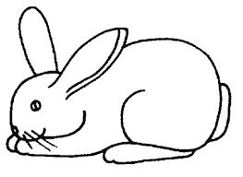
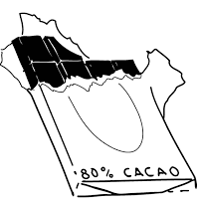
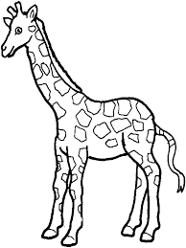
Prénom :
Date :
 | A a A ²a
Phonologie
1. j Colorie ²le$ ²images ²si ²tu ²entend$ ²le ²son [a] :
2. j Colorie ²la ²syllabe ²où ²tu ²entend$ ²le ²son [a] :
⚪️⚪️
⚪️⚪️⚪️
⚪️⚪️
3. j Colorie ²le$ ²lettre$ a :
o | u | h | i | o | g | a | s | j | k | m | L | N
U | h | B | v | X | A | f | a | T | r | I | P | j
x | W | v | f | A | a | J | A | a | o | L | N | p
P | g | u | a | a | e | C | u | a | a | T | l | s
y | r | a | a | A | a | a | A | A | a | a | R | q
v | a | a | h | t | R | d | b | j | K | a | a | X
a | a | s | e | u | i | G | d | R | n | l | a | a
grainesdelivres.fr

Slide 2
Prénom :
Date :
 | I i I ²i
Phonologie
1. j Colorie ²le$ ²images ²si ²tu ²entend$ ²le ²son [i] :
2. j Colorie ²la ²syllabe ²où ²tu ²entend$ ²le ²son [i] :
⚪️⚪️
⚪️⚪️⚪️
⚪️⚪️
3. j Colorie ²le$ ²lettre$ i :
o | u | h | i | o | g | a | s | j | k | m | L | N
U | h | B | v | X | I | i | a | i | I | j | P | j
x | W | v | f | i | a | J | I | a | o | i | N | p
P | g | u | a | a | e | C | i | a | a | T | l | s
y | r | a | i | I | i | i | I | I | A | a | R | q
v | a | i | i | i | I | i | I | i | I | a | a | X
a | a | s | e | u | j | G | d | R | n | l | a | a

Slide 3
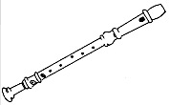
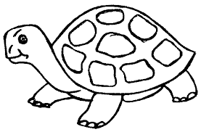
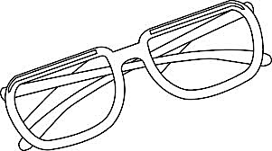
Prénom :
Date :
 | U u U ²u
Phonologie
1. j Colorie ²le$ ²images ²si ²tu ²entend$ ²le ²son [y] :
2. j Colorie ²la ²syllabe ²où ²tu ²entend$ ²le ²son [y] :
⚪️⚪️
⚪️⚪️️
⚪️⚪️
3. j Colorie ²le$ ²lettre$ u :
o | p | U | u | o | g | a | s | j | u | u | L | N
U | h | U | U | X | I | i | a | i | U | u | P | j
x | W | u | U | i | a | J | I | a | u | u | N | p
P | g | U | u | a | e | C | i | a | u | U | l | s
y | r | a | u | U | i | i | I | U | u | a | R | q
v | a | i | i | u | U | i | U | u | I | a | a | X
a | a | s | e | u | u | U | u | R | n | l | a | a

Slide 4
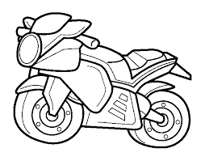
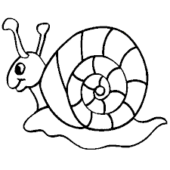
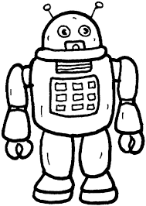
Prénom :
Date :
 | O o O ²o
Phonologie
1. j Colorie ²le$ ²images ²si ²tu ²entend$ ²le ²son [o] :
2. j Colorie ²la ²syllabe ²où ²tu ²entend$ ²le ²son [o] :
⚪️⚪️
⚪️⚪️⚪️
⚪️⚪️
3. j Colorie ²le$ ²lettre$ o :
l | u | h | i | j | g | O | p | j | k | m | L | N
U | h | B | v | O | O | i | o | o | I | j | P | j
x | W | v | O | o | a | J | I | o | o | i | N | p
P | g | o | o | a | e | C | i | a | o | O | l | s
y | r | a | o | O | i | a | I | O | o | a | R | q
v | a | i | i | o | O | i | O | o | I | a | a | X
a | a | s | e | u | o | O | o | R | n | l | a | a

Slide 5
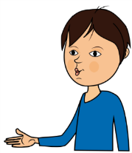
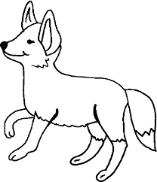
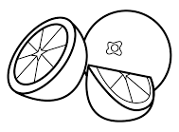
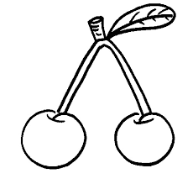
Prénom :
Date :
 | E e E ²e
Phonologie
1. j Colorie ²le$ ²images ²si ²tu ²entend$ ²le ²son [ǝ] :
2. j Colorie ²la ²syllabe ²où ²tu ²entend$ ²le ²son [ǝ] :
⚪️⚪️
⚪️⚪️⚪️
⚪️⚪️
3. j Colorie ²le$ ²lettre$ e :
l | u | h | i | e | e | E | e | e | k | m | L | N
U | h | B | v | E | O | i | o | o | I | j | P | j
x | W | v | O | e | a | J | I | o | o | i | N | p
P | g | o | o | e | e | E | e | a | o | O | l | s
y | r | a | o | E | i | a | I | O | o | a | R | q
v | a | i | i | e | O | i | O | o | I | a | a | X
a | a | s | o | E | e | E | e | E | n | l | a | a

Slide 6
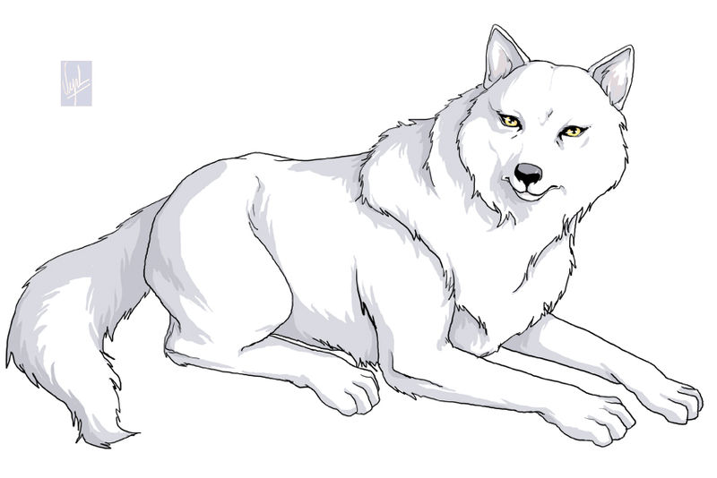
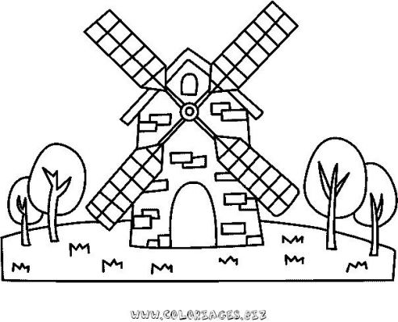
Prénom :
Date :
 | L l L ²l
Phonologie
1. j Colorie ²le$ ²images ²si ²tu ²entend$ ²le ²son [l] :
2. j Colorie ²la ²syllabe ²où ²tu ²entend$ ²le ²son [l] :
⚪️⚪️
⚪️⚪️⚪️
⚪️⚪️
⚪️⚪️
3. j Colorie ²le$ ²lettre$ l :
l | u | h | i | j | g | O | p | j | k | m | L | N
U | h | L | k | O | O | i | o | o | I | j | P | l
x | W | v | O | l | a | J | I | o | o | i | L | p
P | l | o | o | a | e | C | i | a | o | O | l | s
y | r | a | l | O | i | a | I | O | o | a | R | q
h | a | l | i | o | O | i | L | o | I | a | a | X
a | a | l | e | u | o | L | b | R | n | l | a | a
3. j Colorie ²le$ ²lettre$ o :

Slide 7
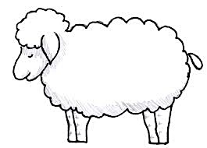
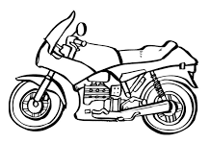
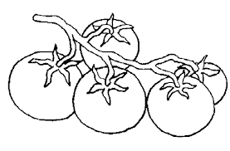
Prénom :
Date :
 | M m M m
Phonologie
1. j Colorie ²le$ ²images ²si ²tu ²entend$ ²le ²son [m] :
2. j Colorie ²la ²syllabe ²où ²tu ²entend$ ²le ²son [m] :
⚪️⚪️
⚪️⚪️⚪️
⚪️⚪️⚪️⚪️
⚪️⚪️
3. j Colorie ²le$ ²lettre$ m :
l | u | h | i | j | g | O | p | j | k | m | L | N
U | h | M | m | O | O | i | o | o | M | m | P | l
x | W | m | M | m | a | J | I | M | m | m | L | p
P | l | M | m | a | m | C | m | a | m | M | l | s
y | r | m | m | O | i | m | I | O | M | m | R | q
h | a | m | m | o | O | i | L | o | M | m | a | X
a | a | l | e | u | o | L | b | R | n | l | a | a
3. j Colorie ²le$ ²lettre$ o :

Slide 8
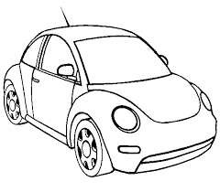
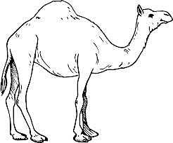
Prénom :
Date :
 | R r R ²r
Phonologie
1. j Colorie ²le$ ²images ²si ²tu ²entend$ ²le ²son [r] :
2. j Colorie ²la ²syllabe ²où ²tu ²entend$ ²le ²son [r] :
⚪️⚪️
⚪️⚪️⚪️
⚪️⚪️⚪️⚪️
⚪️⚪️
3. j Colorie ²le$ ²lettre$ r :
l | u | h | i | j | g | O | p | j | k | m | L | N
U | h | M | r | R | R | r | r | o | M | m | P | l
x | W | m | R | r | a | J | I | R | m | m | L | p
P | l | M | r | r | r | R | r | a | m | M | l | s
y | r | m | r | R | i | r | I | O | M | m | R | q
h | a | m | r | r | O | i | R | o | M | m | a | X
a | a | l | r | r | o | L | b | R | n | l | a | a
3. j Colorie ²le$ ²lettre$ o :

Slide 9
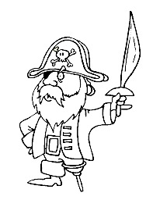
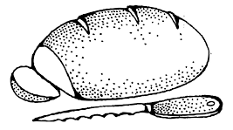
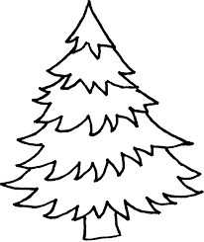
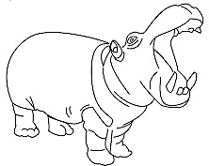
Prénom :
Date :
 | P p P ²p
Phonologie
1. j Colorie ²le$ ²images ²si ²tu ²entend$ ²le ²son [p] :
2. j Colorie ²la ²syllabe ²où ²tu ²entend$ ²le ²son [p] :
⚪️⚪️
⚪️⚪️⚪️
⚪️⚪️⚪️⚪️
⚪️⚪️
3. j Colorie ²le$ ²lettre$ p :
l | u | h | i | j | g | O | q | j | k | m | L | N
U | h | M | p | p | P | P | p | o | M | m | q | l
x | W | m | P | P | a | J | I | P | q | m | L | q
Q | l | M | p | p | p | P | p | a | m | M | l | s
y | r | m | p | P | i | r | I | O | M | m | R | q
h | a | m | p | p | O | i | R | o | M | m | a | X
a | a | l | P | p | o | L | b | R | n | l | a | a
3. j Colorie ²le$ ²lettre$ o :

Slide 10
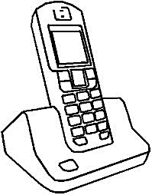
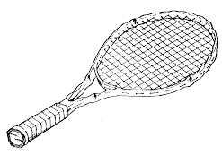
Prénom :
Date :
 | T t T ²t
Phonologie
1. j Colorie ²le$ ²images ²si ²tu ²entend$ ²le ²son [t] :
2. j Colorie ²la ²syllabe ²où ²tu ²entend$ ²le ²son [t] :
⚪️⚪️
⚪️⚪️⚪️
⚪️⚪️⚪️⚪️
⚪️⚪️
3. j Colorie ²le$ ²lettre$ t :
l | u | h | i | j | g | O | q | j | k | m | L | N
U | h | T | t | t | T | T | t | t | T | m | q | l
x | W | t | T | T | t | t | T | t | T | o | L | q
Q | l | M | p | p | t | T | p | a | m | M | l | s
y | r | m | p | P | t | t | I | O | M | m | R | q
h | a | m | r | p | T | t | R | o | M | h | a | X
a | a | l | P | c | t | T | b | R | n | l | a | a

Slide 11
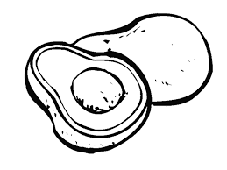
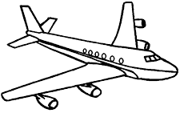
Prénom :
Date :
 | V v V v
Phonologie
1. j Colorie ²le$ ²images ²si ²tu ²entend$ ²le ²son [v] :
2. j Colorie ²la ²syllabe ²où ²tu ²entend$ ²le ²son [v] :
⚪️⚪️
⚪️⚪️⚪️
⚪️⚪️⚪️⚪️
⚪️⚪️
3. j Colorie ²le$ ²lettre$ v :
l | u | h | i | j | g | O | q | j | k | m | L | N
V | v | T | l | u | T | u | a | t | T | m | v | V
x | V | v | l | T | t | m | U | t | T | v | V | q
Q | l | V | v | p | t | w | p | a | v | V | l | s
y | r | m | v | V | t | t | I | V | v | m | R | q
h | a | m | r | v | V | t | V | v | M | h | a | X
a | a | l | P | c | v | V | v | R | n | l | a | a
3. j Colorie ²le$ ²lettre$ o :

Slide 12
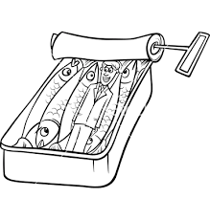
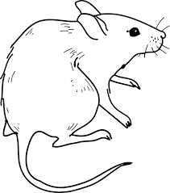
Prénom :
Date :
 | S s S ²$
Phonologie
1. j Colorie ²le$ ²images ²si ²tu ²entend$ ²le ²son [s] :
2. j Colorie ²la ²syllabe ²où ²tu ²entend$ ²le ²son [s] :
⚪️⚪️
⚪️⚪️⚪️
⚪️⚪️⚪️⚪️
⚪️⚪️
3. j Colorie ²le$ ²lettre$ s :
l | u | h | $ | j | g | O | q | j | k | m | C | N
U | h | T | t | s | T | T | $ | t | S | c | q | l
x | W | t | T | S | s | s | T | s | C | o | L | q
Q | l | C | p | s | t | a | s | a | m | M | l | s
y | r | m | p | P | c | t | I | O | S | m | R | q
h | $ | m | r | p | C | $ | S | o | S | h | a | X
a | a | l | C | c | t | T | b | R | n | l | a | a
3. j Colorie ²le$ ²lettre$ o :

